Slide 1

Urinary tract infection

Slide 2
Introduction
Urinary tract system or renal electrolyte system
Functions:There are several functions some of the important :-
Removal of waste product from the body (mainly urea and uric acid)
Regulation of electrolyte balance (e.g. sodium, potassium and calcium)
Regulation of acid-base homeostasis
Controlling blood volume and maintaining blood pressure

Slide 3
Contd...
The urinary tract consists of kidneys, ureters, bladder and urethra.
Urinary tract infections is the infection of urethra, bladder, and kidneys (urethritis, cystitis, and pyelonephritis, respectively), and infections of the prostate such as acute prostatitis.
Urinary tract are joined by a fluid medium, infection at any site may spread to involve other areas of the system.
The presence of bacteria in urine is called bacteriuria and it is usually accompanied by pus cells in urine (pyuria).
It is usually regarded as significant when the urine contains 10⁵organisms or more per ml in pure culture.

Slide 4
Epidemology
Womens are commonly infected.
About 30 times more often than men; roughly one in five women experiences a UTI in her lifetime.
Girls and women are at high risk of infection because of
- the short female urethra,
-Sexual intercourse,
-Uses of contraceptics,
-pregnancy.
(when there may be partial stagnation of the urine on the urinary tract, significantly increase the susceptibility of women to UTI. )

Slide 5
Etiological agent
The possible pathogens in urine are;
Staphylococcus saprophyticus, Escherichia coli, Proteus species, Haemolytic streptococci, Pseudomonas aeruginosa, Klebsiella strains, Salmonella typhi, Salmonella paratyphi, Neisseria gonorrhoeae.
Similarly, Mycobacterium tuberculosis, Leptospira interrogans, Chlamydia, Mycoplasma can also be found.
In rare cases, fungal organisms, such as Candida sp and Coccidioides, may be involved in complicated UTIs,

Slide 6
In addition, parasites, as well as viruses have been also identified as infrequent causes of UTIs.
Parasites such as Schistosoma haematobium, Trichomonas vaginalis, and occasionally Enterobius vermicularis, Wuchereria bancrofti and Onchocerca volvulus are also found.
Viruses-HSV-2 (herpes simplex virus type 2)

Slide 7
E coli is the commonest cause of urinary tract infection(normally inhabits the bowel, where it is relatively harmless. These organisms become a cause of UTI only when they enter the urethra).
Followed by Proteus, Klebsiella and Pseudomonas sp.

Slide 8
M tuberculosis is often suspected where there is pyuria but routine culture is sterile.
S typhi and S paratyphi can be found in urine of patients with enteric fever from the fourth week of infection.

Slide 9


Slide 10
Urinary Tract Diseases:
Urethritis:is inflammation of the urethra. The most common symptom is painful or difficult urination
Cystitis: irritation of the mucosal surface of the urethra as well as the bladder leading to inflammation. The symptoms of cystitis are dysuria(painful urination), frequent urination. With cloudy and occasionally frankly bloody urine. Fever and systemic manifestations of illness

Slide 11
Pyelonephritis
Pyelonephritis results when a UTI progresses to involve the upper urinary system (the kidneys and ureters).
It the inflammation of renal parenchyma and pelvis which develops and result into Acute Kidney injury.
Pyelonephritis is a potentially serious kidney infection that can spread to the blood, causing severe illness.

Slide 12
Synptoms:
Pyelonephritis may start with similar symptoms. However, once the infection has spread to the kidney, signs of more severe illness usually result:
Back pain
Fever (usually present) and/or chills
Feeling sick (malaise)
Nausea and vomiting
Confusion (especially in the elderly)
Pyelonephritis may cause noticeable changes in the urine, such as:
Blood in the urine (hematuria)
Cloudy or foul-smelling urine
Pain when urinating
Increased frequency or urgency of urination

Slide 13
Lab diagnosis
Sample: clean-voided midstream urine
when clean-voided MSU cannot be obtained catheterization or suprapubic aspiration is taken.
Midstream urine (MSU) for microbiological examination is collected as follows:
- Give the patient a sterile, dry, wide-necked, leakproof container and request a 10–20 ml specimen.
(Important: Explain to the patient the need to collect the urine with as little contamination as possible, i.e. a ‘clean-catch’ specimen.)
Female patients: Wash the hands. Cleanse the area around the urethral opening with clean water, dry the area with a sterile gauze pad, and
collect the urine with the labia held apart.
Male patients: Wash the hands before collecting a specimen (middle of the urine flow).

Slide 14
Catheter urine sample(CSU):-If the patient is catheterized the sample is collected as follows:- catheter is cleaned with the alcohol and aspirated with the syringe never collected from uro bag or drainage tube
Suprapubic aspiration:- from children, older women and infant. Gold standard technique.
Early morning sample(EMU):- If renal tuberculosis is suspected. Three urine sample is collected in consecutive days. Entire morning sample is collected

Slide 15
Transport:-
Sample must be transported at room temperature within a half an hour.
If delay refrigerated at 4 degree celcius. Behond 4 hrs the sample should not be processed for bacterial culture.
If the sample is from the patient who is not from immediate health facility urine can be kept in the container using 1.8% boric acid for 24 hrs

Slide 16
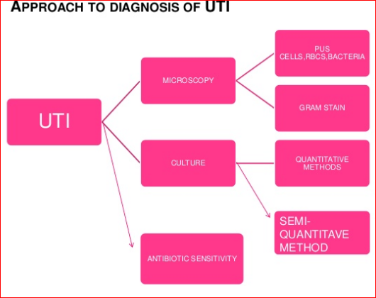

Slide 17
Macroscopic examination
Urine is examined macroscopically as:
Colour
Transparency
Freshly passed urine is clear pale yellow to yellow.
Notes:
milky fluid containing fat droplets which drains from the lacteals of the small intestine into the lymphatic system during digestion.

Slide 18
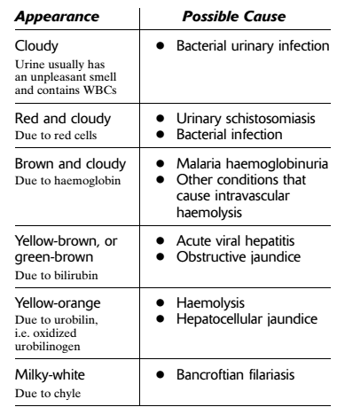

Slide 19
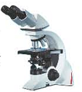
Microscopy
Urine is examined microscopically as a
wet mount preparation to detect:
significant pyuria, i.e. WBCs in excess of 10 cells/μl of urine
red cells
Casts and crsytal
yeast cells
T. vaginalis motile trophozoites
Schistosoma haematobium eggs
bacteria (provied fresh urinegram staining)
AFB staining of urine sediments if renal tuberculosis is suspected.

Slide 20
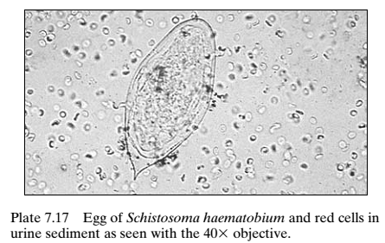
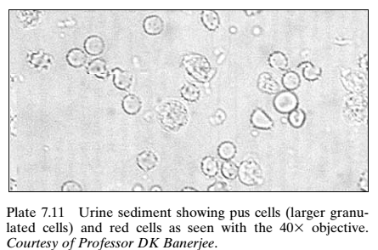
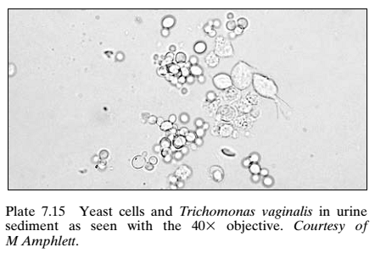
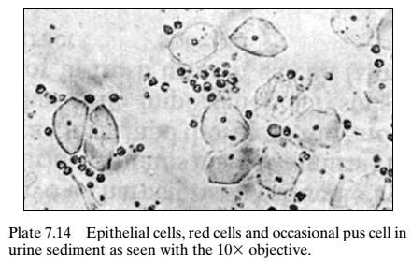

Slide 21
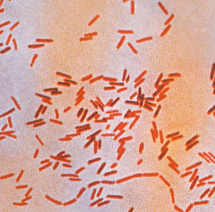
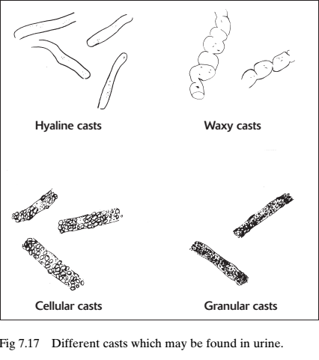
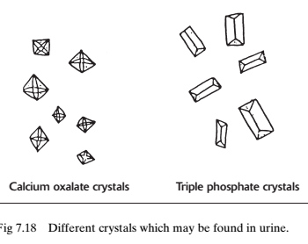

Slide 22
Biochemical testing
Biochemical tests which are helpful in investigating UTI include(Uristick)
Protein (Proteinuria is found in most bacterial urinary tract infections.) The presence of abnormal quantities of protein in the urine, which may indicate damage to the kidneys.
Nitrite (Urinary pathogens, e.g. E. Coli, Proteus species, and Klebsiella species, are able to reduce the nitrate normally present in urine to nitrite. This can be detected by the nitrite reagent strip test.)
Leukocyte esterase test is the test used to detect esterase (a type of enzyme) produced by leukocytes (white blood cells). A leukocyte esterase test (LE test) is a urine test for the presence of white blood cells and other abnormalities associated with infection. White blood cells in the urine usually indicate a urinary tract infection. It detects the enzyme from both active and lyzed WBCs. LE testing is an alternative method of detecting pyuria when it is not possible to examine fresh urine microscopically for white cells or when the urine is not fresh and likely to contain mostly lyzed WBCs.)

Slide 23
Other tests
glucose, ketones, bilirubin, urobilinogen, and haemoglobin)- all increases indicating infections

Slide 24
Culture
Culture is required when the urine contains
bacteria (as indicated by the Gram smear), cells, casts, protein, nitrite, or has a markedly alkaline or acid reaction.
Culture on Cystine lactose electrolyte-deficient (CLED) agar or in blood agar and MacConkey agar for routine purpose.
If significant growth, identify by biochemical test and perform Antibiotic sensitivity Test (Nitrofurantion,Amikacin,Norfloxacin,Ciprofloxacin, Cefixime)
Obtained colonies are gram stained and biochemical tests were performed

Slide 25
